Slide 1
Chapter 1-1 Fundamentals of Quantitative Design and Analysis

Slide 2
Topics in Chapter 1
1.1 Introduction
1.2 Classes of computers
1.3 Defining computer architecture and What’s the task of computer design?
1.4 Trends in Technology
1.5 Trends in power in Integrated circuits
1.6 Trends in Cost
1.7 Dependability
1.8 Measuring, Reporting and summerizing Perf.
1.9 Quantitative Principles of computer Design
1.10 Putting it altogether

Slide 3
What’s CA?
What’s a CA designer’s task ?

Slide 4
What’s Computer Architecture
Patterson’s talk : “50 years of Computer Architecture”
https://www.bilibili.com/video/av46710093/
The future of computing- a conversation with John Hennessy
https://www.bilibili.com/video/av23283946/
Technology
A key factor in the long run of CPU performance improvement.

Slide 5
iEvolution of computer marketeomputer
Original:
Big Fishes Eating Little Fishes

Slide 6
1988 Computer Food Chain
iEvolution of computer marketeomputer
* Microprocessor performance improvement: 35% yearly
* Cost advantages of a mass-produced microprocessor
Mainframe
Work-
station
PC
Mini-
supercomputer
Mini-
computer
Supercomputer
Easier success of new architecture:
Virtual elimination of assembly language programming
Creation of standardized vendor-independent OS
Massively Parallel Processors

Slide 7
Evolution of computer market
Mini-
supercomputer
Mini-
computer
Massively Parallel Processors
Embedded system
Mainframe
mobile
phone
Work-
station
PC
Server
Supercomputer
RISC-based computers raised performance bar: RISC replace CISC
In low-end application, power performance: ARM replace x86

Slide 8
Newest computer market
Embedded system
Cloud
Server
Mainframe
smart
Phone
&
Tablet
Work-
station
PC
Server
Supercomputer

Slide 9
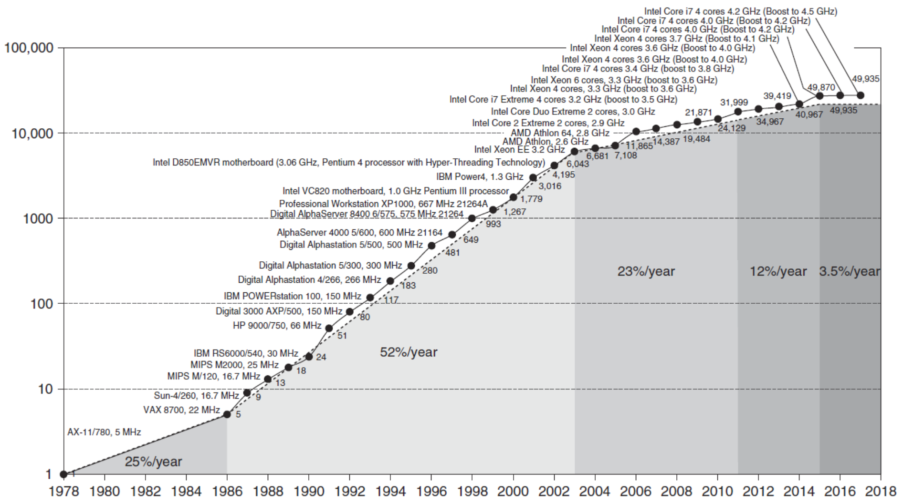
Incredible CPU performance improvement
VAX : 25%/year 1978 to 1986； RISC+x86: 52%/year 1986 to 2002； RISC+x86: 22%/year after 2002

Slide 10
What the figure tell us ?
Performance improvements:
25%: Technological improvements more steady than progress in computer architecture.
Feature size, clock speed
52%: After RISC emergence, computer design emphasized both architectural innovation and efficient use of technology improvements.
Computer Architecture plays an important role in performance improvement
Pipeline, dynamic scheduling, ooo, branch prediction,
speculation, superscalar, VLIW, prediction instructions, ……

Slide 11
Effect of dramatic growth rate during 20th centrury
Technology Advances
CMOS VLSI dominates older technologies (TTL, ECL) in cost AND performance
Computer architecture advances
RISC, superscalar, OOO, Speculation, VLIW, RAID, …
Enhanced the capability of computer users:
perfmicroprocessor > supercomputer 20 years ago
New class of computer
PC、work station→mobile phone, laptops access warehouse containing millions of servers
Donimance of microprocessor-based computers across the computer design
Minicomputer→ server , mainframe, supercomputer → collections of microprocessor
Change software
Trade performance for productivity c,c++ → java, scala; javaScript, Python，
Change nature of applications: scientific calculation→ speech, image, video

Slide 12
What’s Computer Architecture
Concept Evolution
The attributes of a [computing] system as seen by the programmer, i.e.,
the conceptual structure and functional behavior, as distinct from the organization of the data flows and controls the logic design, and the physical implementation.
Amdahl, Blaaw, and Brooks, 1964

Slide 13
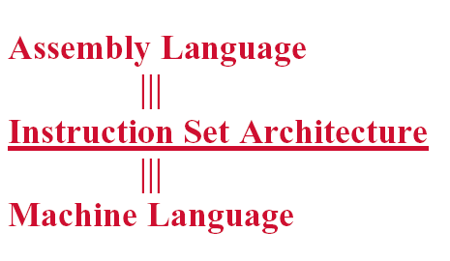
Computer Architecture = ISA ？
Notes:
From the view of language, a computer can be viewed as multiple level virtual machine.
How can we improve the performance ? We explore the parallelisms.

Slide 14
Seven dimensions of ISA
Class of ISA
Memory addressing
Addressing modes
Types and sizes of operands
Operations
Control flow instructions
Encoding an ISA

Slide 15
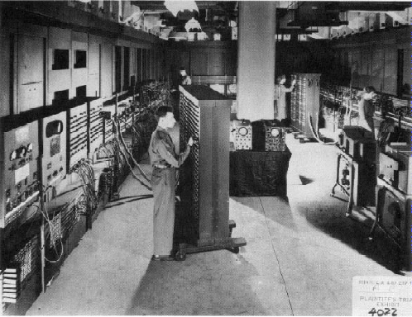
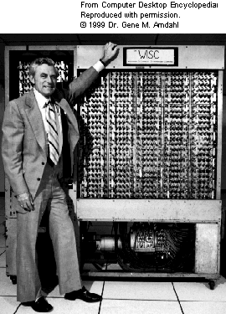
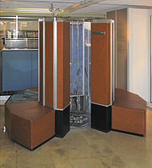
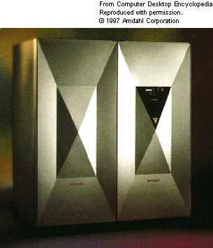
Very different appearance

Slide 16
Very Different ISA
PDP-11
IBM 360
VAX
CRAY
…
LC3
80x86
PowerPC
MIPS
ARM
RISC V

Slide 17



主流CPU发展路径
Intel
X86
4004
8008
8086
80286
386
486
pentium
pentiumII
pentiumIII
pentiumIV
Core
286
386
486
K5
K6
K7
K8
K10
POWER1
POWER2
POWER3
POWER4
POWER5
POWER6
PPC
IBM801
PowerPC600
PowerPC700
PowerPC9xx
BE(cell)
MPC750
MPC7400
e100/e200
e300/e500
e600
Pxxxx
MIPS
MIPS3k
MIPS4K
MIPS5K
MIPS10K
MIPS32/64
ARM
ARM7
ARM9
ARM10
ARM11
1970s
1980s
1990s
2000s

Slide 18
New Concepts ?
Tradeoff
Computer Architecture is the science and art of selecting and interconnecting hardware components to create computers that meet functional, performance, cost and power goals.
It is a blueprint and functional description of requirements and design implementations for the various parts of a computer, focusing largely on the way by which the central processing unit (CPU) performs internally and accesses addresses in memory.

Slide 19
Computer architecture
Computer architecture comprises at least three main subcategories:^{[1]}
Instruction set architecture,
Microarchitecture, also known as Computer organization is a lower level, more concrete and detailed, description of the system that involves how the constituent parts of the system are interconnected and how they interoperate in order to implement the ISA.[
System Design which includes all of the other hardware components within a computing system such as:
Logic Implementation
Circuit Implementation
Physical Implementation

Slide 20
The Task of Computer Design
Determine the important attributes of a new machine to maximize performance while staying with constrains, such as cost, power, availability, etc.
instruction set architecture design
functional organization
High level aspects of computer design, i.e. memory system, bus architecture and internal CPU design.
logic design ( hardware )
implementation (hardware )

Slide 21
Incredible CPU performance improvement
VAX : 25%/year 1978 to 1986； RISC+x86: 52%/year 1986 to 2002； RISC+x86: 22%/year after 2002

Slide 22
Why lower down after 2004 ？Three changes
Technology
End of Dennard scaling: power becomes key constraint
Power density was constant for a given area of silicon even as increase the number of transistors
Slowdown in Moore’s Law： transistors cost（even unused）
Architectural
Limitation and Inefficiencies in exploiting ILP and the uniprocessor era.
Amdahl’s Law and its implications end the “easy” multicore era
Application focus shifts
From desktop to individual, mobile devices and ultrascale cloud computing: new constraints.

Slide 23
Challenges of “three walls”
ILP Wall
diminishing returns on finding more ILP HW (Explicit thread and data parallelism must be exploited)
Memory Wall
growing disparity of speed between CPU and memory outside the CPU chip. Memory latency would become an overwhelming bottleneck in computer performance.
Power Wall
the trend of consuming double the power with each doubling of operating frequency

Slide 24
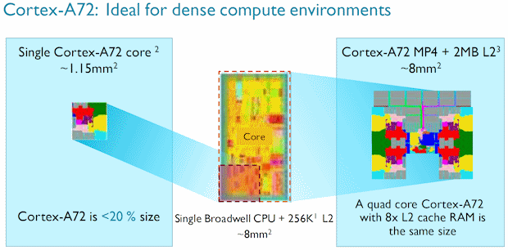
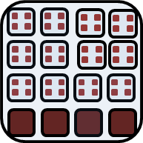
处理器芯片的发展趋势
工艺、主频遇到瓶颈后，开始通过增加核数的方式来提升性能；
芯片的物理尺寸有限制，不能无限制的增加；
ARM的众核横向扩展空间优势明显。
单个X86核面积
~8mm²
单核
多核
众核
单个ARM核面积
~1.15mm²
Notes:
一个ARM核的面积仅为X86核的1/7。
同样的芯片尺寸下，ARM的核数是X86的4倍以上。

Slide 25
现代CPU 发展的一些趋势特点
Z
开放
POWER
SPARC
众核
高端服务器
PA-RISC
POWER
内核数量大量增加，处理器互联。
Itanium
X86
X86
PC & 服务器
封闭架构
异构
MIPS
Moto 68K
ARM
CPU+GPGPU+FPGA
PPC
MIPS
NP
融合
嵌入式/
移动/消费
ARM
内存体系重构，CPU/内存深度融合，内存更贴近计算。
DSP
学习ARM，谋求复生
完全开放，生态良好
过去：架构众多，百花齐放
现在：生态成熟，架构垄断
未来：摩尔定律失效，寻求多方向突破
Notes:
IA：Intel Architecture 。
PPC：PowerPC 。

Slide 26

ARM 服务器级别处理器一览
Hi1612
32C, 2.1GHz
16nm
Hi1616
32C,2.4GHz
16nm
48C,3.0GHz
7nm
Hi1620
CAVIUM
Thunder-X
48C,2.5GHz
28nm
Thunder-X2
32-54C,3.0GHz
14nm
2400
48Cores,2.2-2.6GHz
14nm
高通
X-Gene3
32C, 3.3GHz 16nm
飞腾
FT1500
16 Cores,1.6GHz
28nm
FT2000+
64Cores,2.3GHz
16nm
横轴代表性能

Slide 27
Today, many ISAs on one SoC
Application processor (usually ARM)
Graphics progcessors
Image processors
Radio DSPs
Audio DSPs
Security processors
Power-management processor
> dozen ISAs on some SoCs – each with unique software stack
Why ?
Apps processor ISA too big， inflexible for accelerators
IP bought from different place， each proprietary ISA
Engineers build home-grown ISA cores

Slide 28
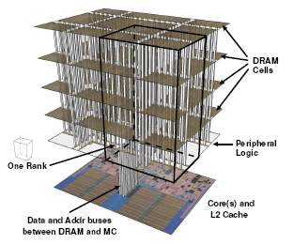
Trends of Computer Architecture
Why?
ILP → TLP(data level parallel)
→ DLP(data level parallel),
Google file system, MapReduce, column-oriented DB
2D memory → 3D stack memory
Performance → Power-aware design

Slide 29
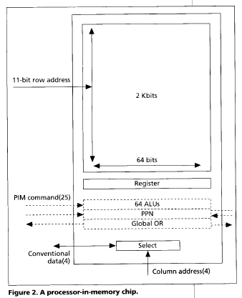
Computational RAM / PIM
Processor in memory (PIM)
Processing in memory (PIM, sometimes called processor in memory) is the integration of a processor with RAM (random access memory) on a single chip. The result is sometimes
known as a PIM chip.
1995. 4 IEEE computer
Processing in memory: the
Terasys massively Parallel PIM Array.

Slide 30
Memory as an Accelerator
CPU
core
CPU
core
Mini-CPU core
GPU
core
GPU
core
Memory
Video
core
CPU
core
CPU
core
GPU
core
GPU
core
Imaging core
Lower Level Cache
Specialized
Compute capability in memory
Memory controller
Bitwise Operation： In-DRAM copy，zero，and，or，not

Slide 31
Recent research fields
Power-aware computer architecture
Reconfigurable computer architecture
Multicore, Manycore,
HPS : P→T→ E-level computer
PIM： Processor in Memory
AI processor -----GPU & FPGA
DSA： Domain Specific Architecture
Hardware and Software Codesign

Slide 32
Where to explore the parallelism ?
Implicity, compiler and hardware
→ Explicity, programmer
So, YOU, programmers have to know parallelism in hardware, and to explore parallelism when design Algorithm and programming !
Parallelism
Hardware → Hardware and compiler → compiler and programmer
ILP, Loop-level Parallism → TLP, DLP

Slide 33
Something more about Computer Architecture

Slide 34
Fastest computer in China
2011 Tianhe-1A - MPP
2008 Dawning 5000A
30720 node * AMD Opteron 1.9Ghz QC
Memory: 122.88TB, Infiniband, 180.6 TeraFLOPS
OS: Windows HPC 2008
Rank 10 in top 500 in Nov. 2008
2004 Dawning 4000A
11 TeraFLOPS
rank 10 in top 500 in June, 2004
2003 ShenTeng6800
5.324 TeraFLOPS
2002 ShenTeng1800
2.04 TeraFLOPS
2000 YinHe IV
1024个CPU
1 TeraFLOPS

Slide 35
What are the fastest computers?
http://top500.org/ June. 2011
1 K computer, SPARC64 VIIIfx 2.0GHz, Tofu interconnect
2 Tianhe-1A - MPP, X5670 2.93Ghz 6C, NVIDIA GPU, FT-1000 8C
3 Jaguar - Cray XT5-HE Opteron 6-core 2.6 GHz
4 Nebulae - Dawning TC3600 Blade, Intel X5650, NVidia Tesla C2050 GPU
5 TSUBAME 2.0 - HP ProLiant SL390s G7 Xeon 6C X5670, Nvidia GPU, Linux/Windows
6 Cielo - Cray XE6 8-core 2.4 GHz
7 Pleiades - SGI Altix ICE 8200EX/8400EX, Xeon HT QC 3.0/Xeon 5570/5670 2.93 Ghz, Infiniband
8 Hopper - Cray XE6 12-core 2.1 GHz
9 Tera-100 - Bull bullx super-node S6010/S6030
10 Roadrunner - BladeCenter QS22/LS21 Cluster, PowerXCell 8i 3.2 Ghz / Opteron DC 1.8 GHz, Voltaire Infiniband

Slide 36
Fastest Supercomputer in the world from http://top500.org/ June. 2013
Rank | Site | System | Cores | Rmax (TFlop/s) | Tpeak (TFlop/s) | Power (kW)
1 | National University of Defense Technology China | Tianhe-2 (MilkyWay-2) - TH-IVB-FEP Cluster, Intel Xeon E5-2692 12C 2.200GHz, TH Express-2, Intel Xeon Phi 31S1P NUDT | 3,120,000 | 33,862.7 | 54,902.4 | 17,808
2 | DOE/SC/Oak Ridge National Laboratory USA | Titan - Cray XK7 , Opteron 6274 16C 2.200GHz, Cray Gemini interconnect, NVIDIA K20x Cray Inc. | 560,640 | 17,590.0 | 27,112.5 | 8,209
3 | DOE/NNSA/LLNL USA | Sequoia - BlueGene/Q, Power BQC 16C 1.60 GHz, Custom IBM | 1,572,864 | 17,173.2 | 20,132.7 | 7,890
4 | RIKEN Advanced Institute for Computational Science (AICS) Japan | K computer, SPARC64 VIIIfx 2.0GHz, Tofu interconnect Fujitsu | 705,024 | 10,510.0 | 11,280.4 | 12,660
5 | DOE/SC/Argonne National Laboratory USA | Mira - BlueGene/Q, Power BQC 16C 1.60GHz, Custom IBM | 786,432 | 8,586.6 | 10,066.3 | 3,945
6 | Texas Advanced Computing Center/Univ. of Texas USA | Stampede - PowerEdge C8220, Xeon E5-2680 8C 2.700GHz, Infiniband FDR, Intel Xeon Phi SE10P Dell | 462,462 | 5,168.1 | 8,520.1 | 4,510
7 | Forschungszentrum Juelich (FZJ) Germany | JUQUEEN - BlueGene/Q, Power BQC 16C 1.600GHz, Custom Interconnect IBM | 458,752 | 5,008.9 | 5,872.0 | 2,301
8 | DOE/NNSA/LLNL USA | Vulcan - BlueGene/Q, Power BQC 16C 1.600GHz, Custom Interconnect IBM | 393,216 | 4,293.3 | 5,033.2 | 1,972
9 | Leibniz Rechenzentrum Germany | SuperMUC - iDataPlex DX360M4, Xeon E5-2680 8C 2.70GHz, Infiniband FDR IBM | 147,456 | 2,897.0 | 3,185.1 | 3,423
10 | National Supercomputing Center in Tianjin China | Tianhe-1A - NUDT YH MPP, Xeon X5670 6C 2.93 GHz, NVIDIA 2050 NUDT | 186,368 | 2,566.0 | 4,701.0 | 4,040

Slide 37
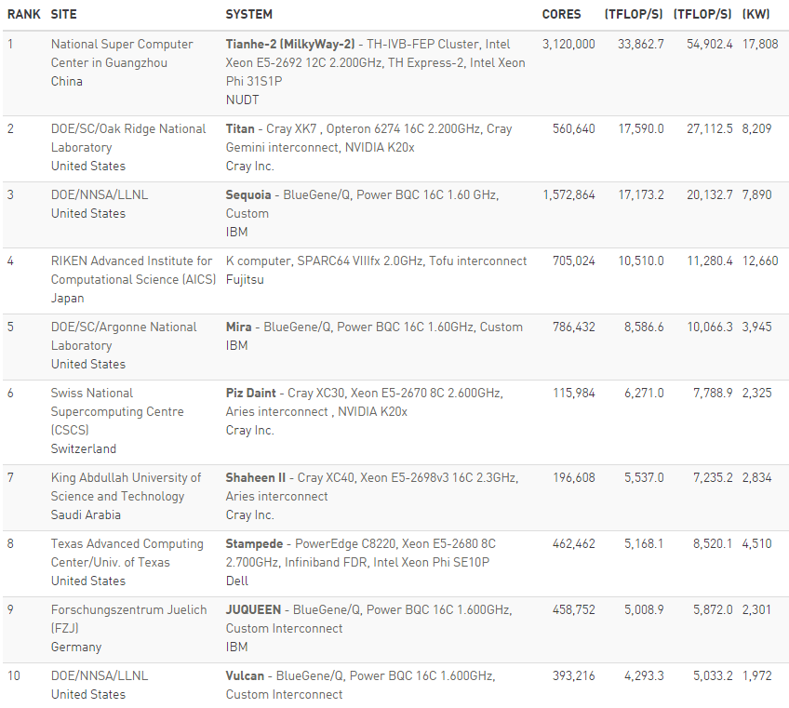
Fastest Supercomputer in the world from http://top500.org/ June，2015

Slide 38
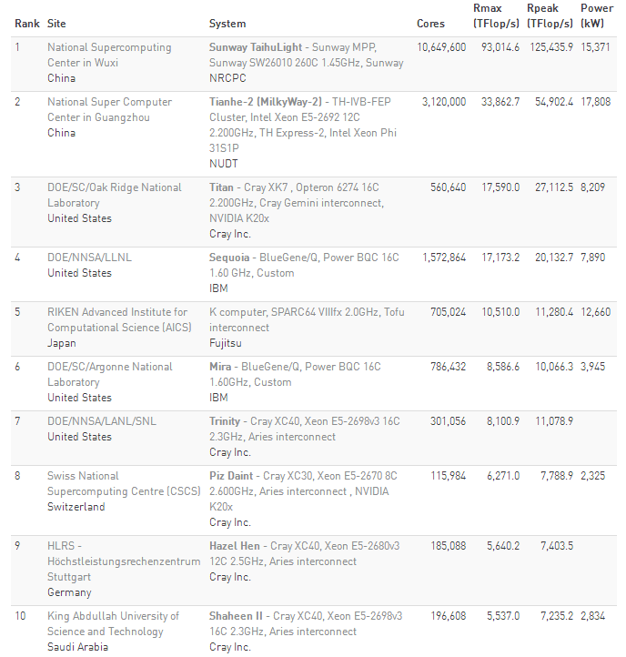
Fastest Supercomputer in the world from http://top500.org/ June. 2016

Slide 39
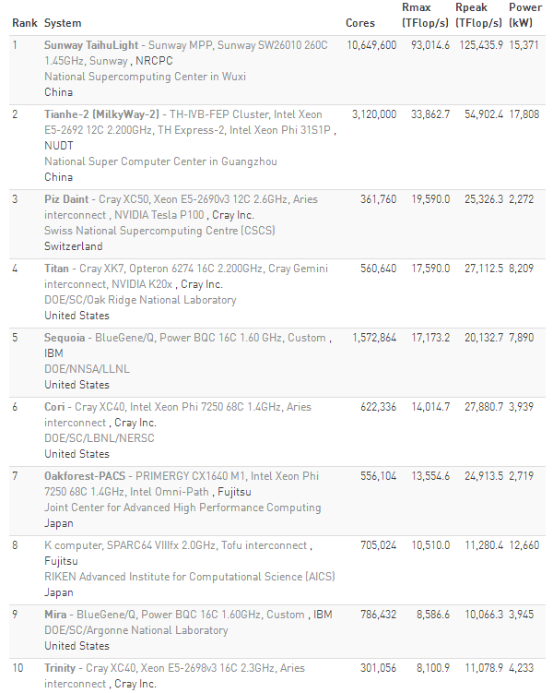
Fastest Supercomputer in the world from http://top500.org/ June. 2017

Slide 40
Overview of TH-2
Items | Configuration
Processors | 32000 Intel Xeon CPUs + 48000 Xeon Phis + 4096 FT CPUs Peak performance is 54.9 Pflops, sustained performance 33.9PFlops
Interconnect | Proprietary high speed interconnection network TH Express-2
Memory | 1.4PB in total
Storage | Global shared parallel storage system, 12.4 PB
Cabinets | 125+13+24+8 = 170 Compute/Communication/Storage/Service Cabinets
Power | 17.8MW
Cooling | Closed Air Cooling System

Slide 41
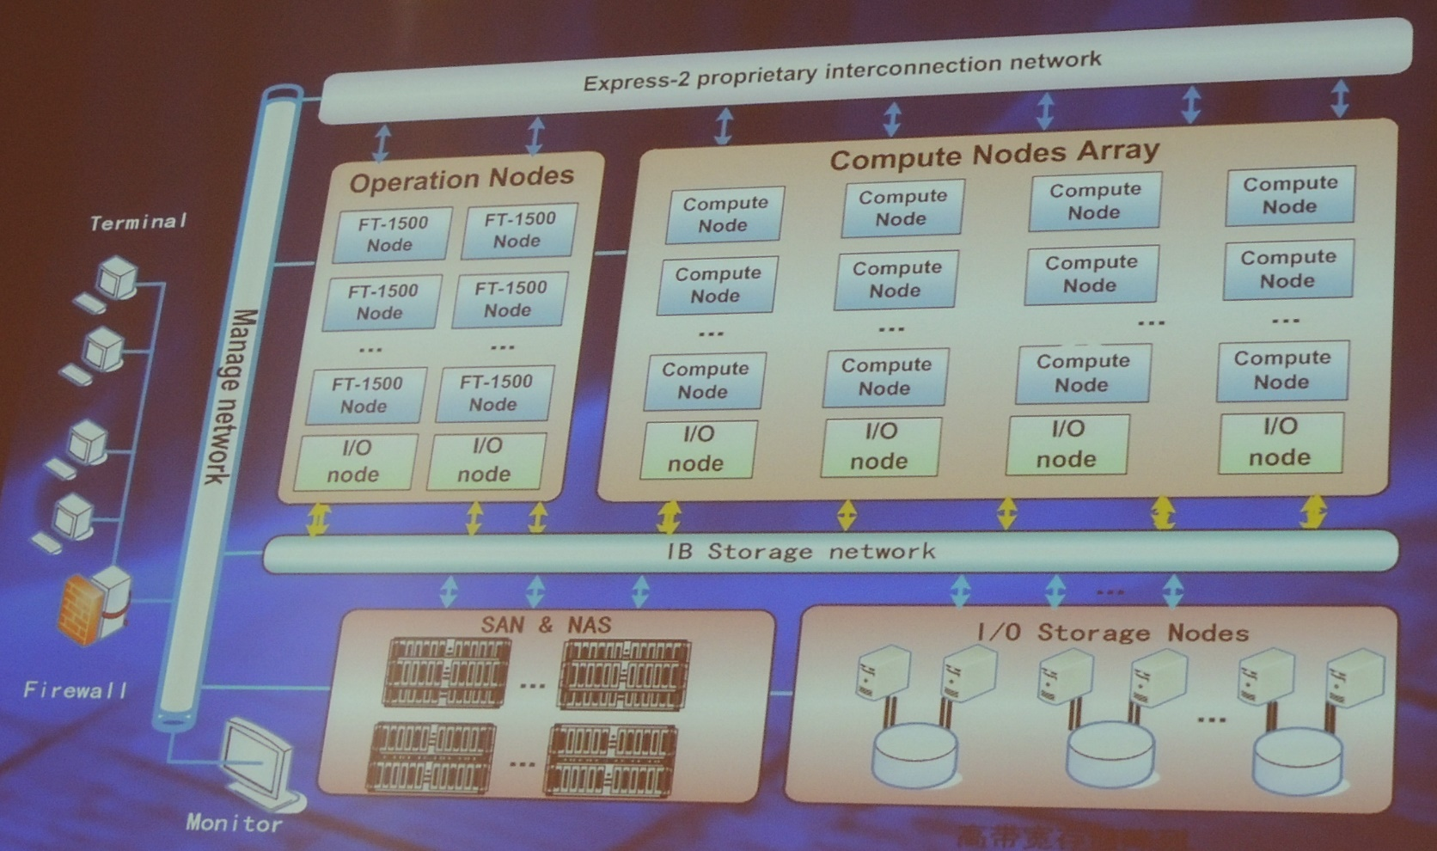
Hardware subsystem of TH-2

Slide 42
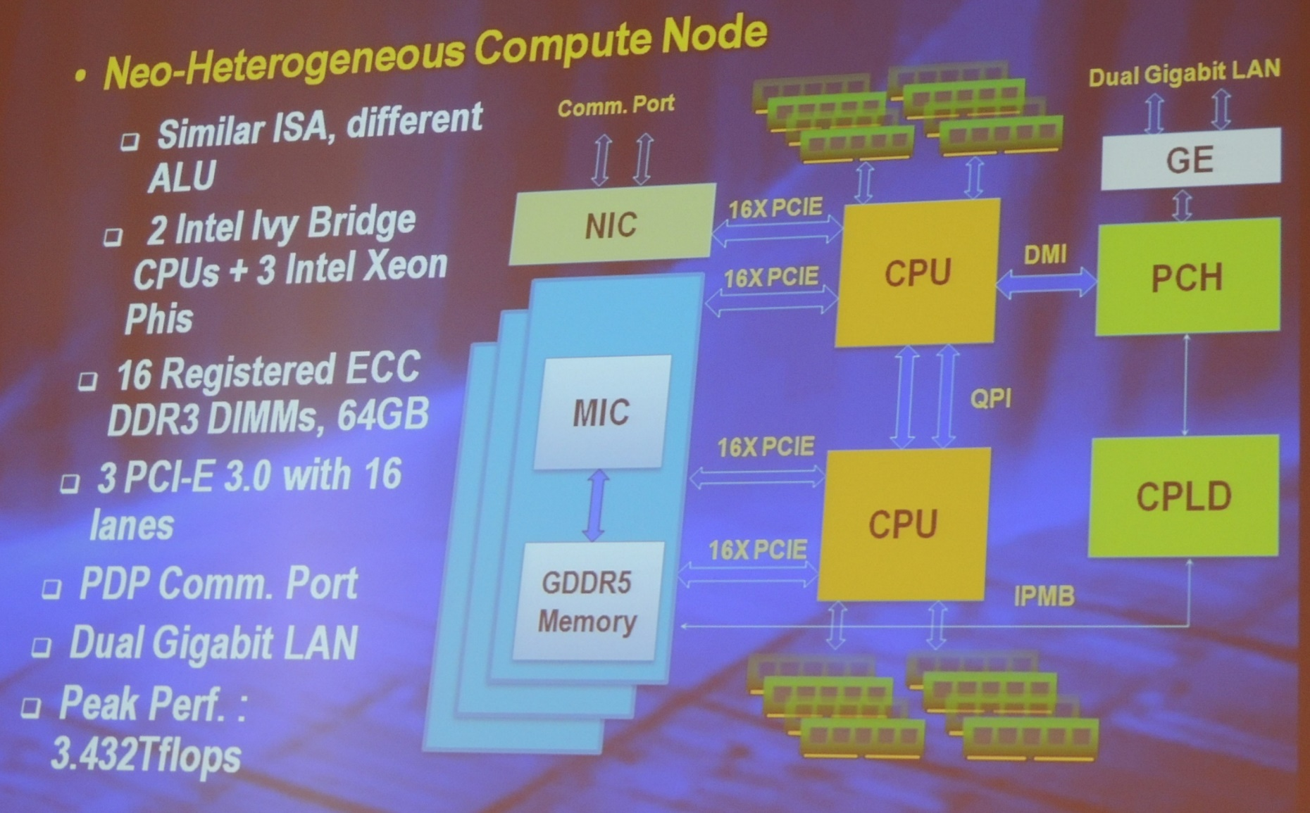
Comuter Node of TH-2

Slide 43
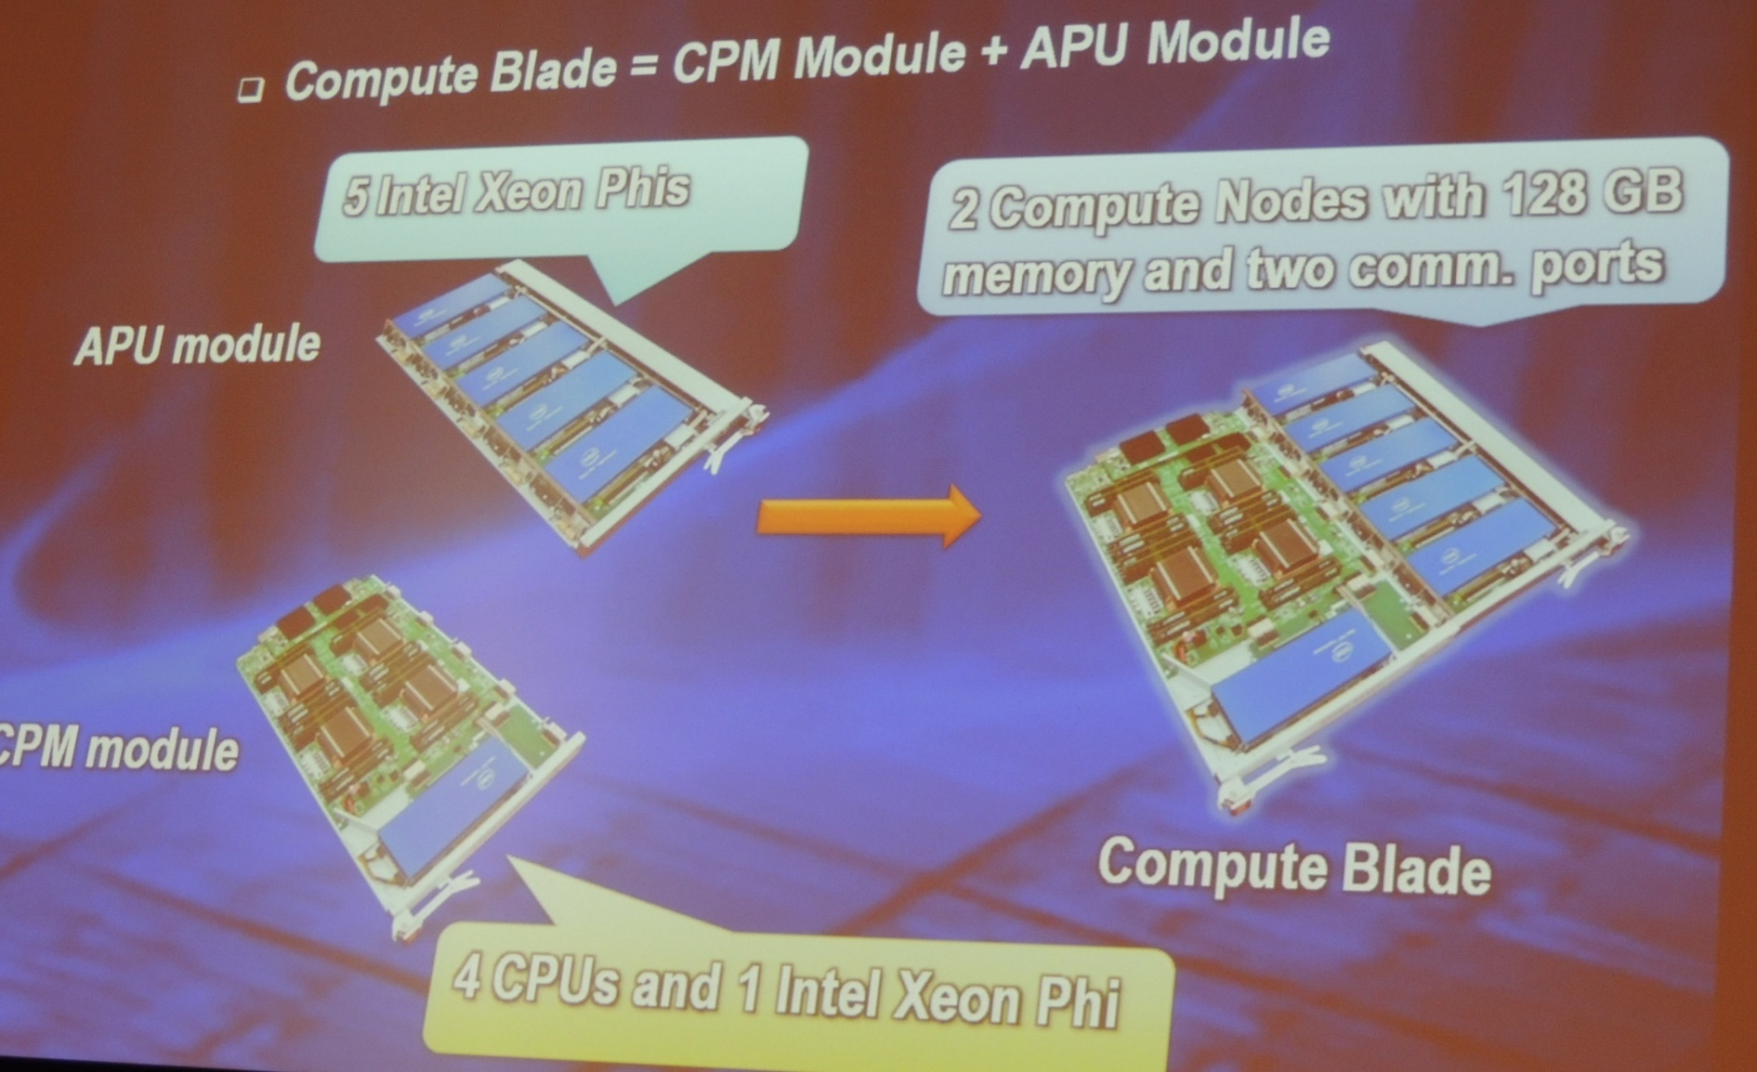
Comuter Node of TH-2

Slide 44
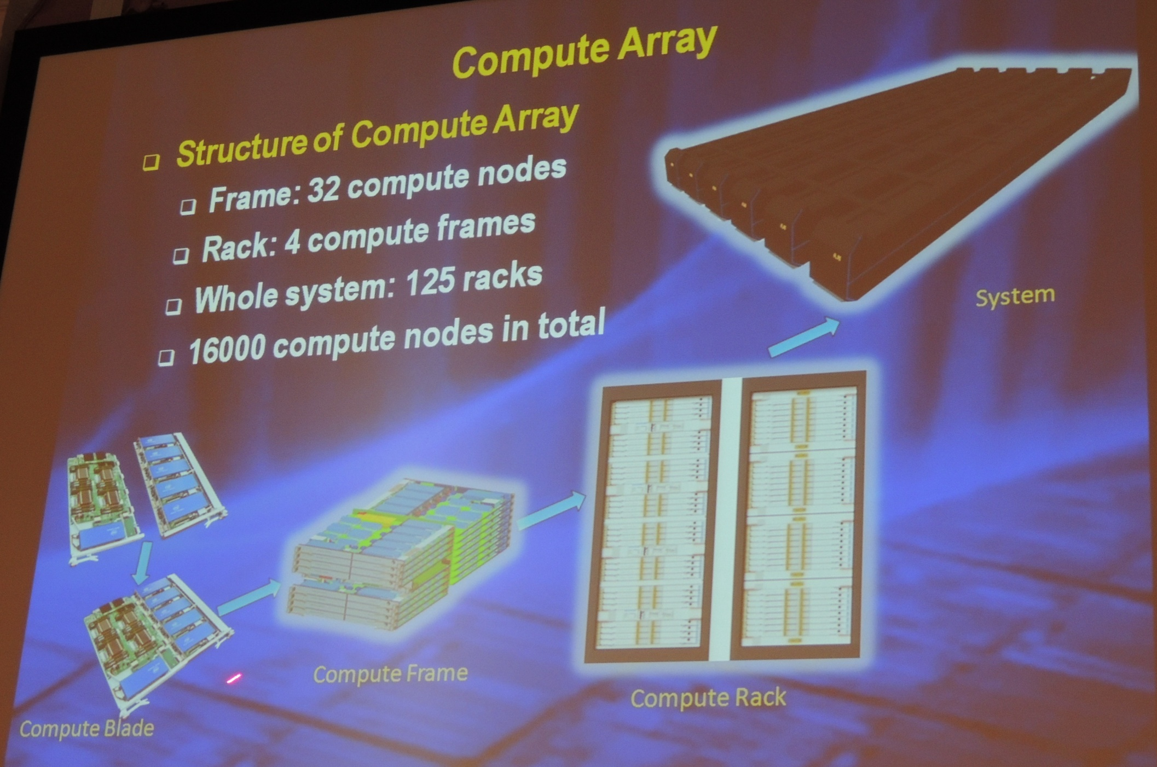
Computer Array of TH-2

Slide 45
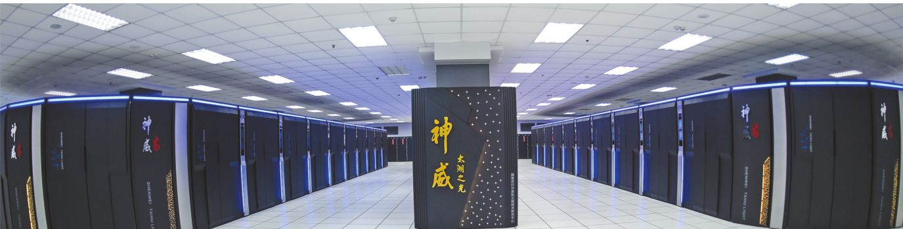
About Taihulight太湖之光
40960 Chinese-designed SW26010 manycore 64-bit RISC processors
X (256 processing cores + 4 auxiliary cores ) per SW26010
= 10,649,600 CPU cores
The processing cores feature 64 KB of scratchpad memory for data (and 16 KB for instructions) and communicate via a network on a chip,
OS: Sunway RaiseOS 2.0.5 on linux with its its own customized implementation of OpenACC2.0

Slide 46
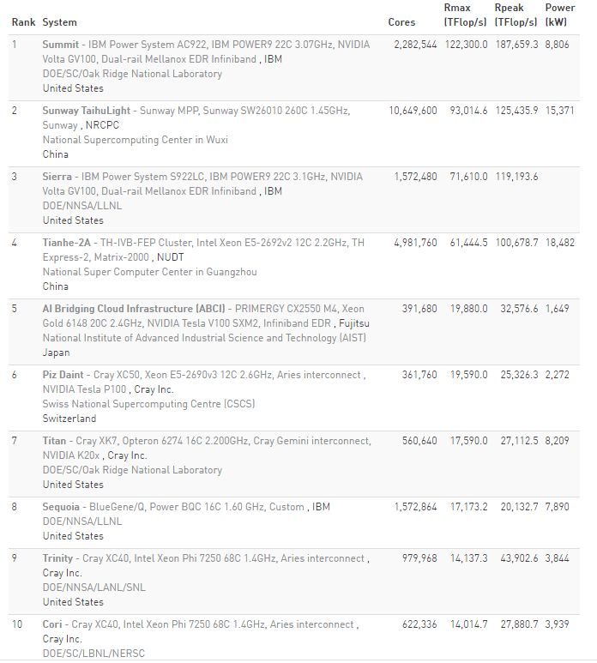
Fastest Supercomputer in the world from http://top500.org/ June. 2018
Summit”的计算能力比神威·太湖之光要快60%，比前美国超级计算机“Titan（泰坦）”要快8倍。

Slide 47
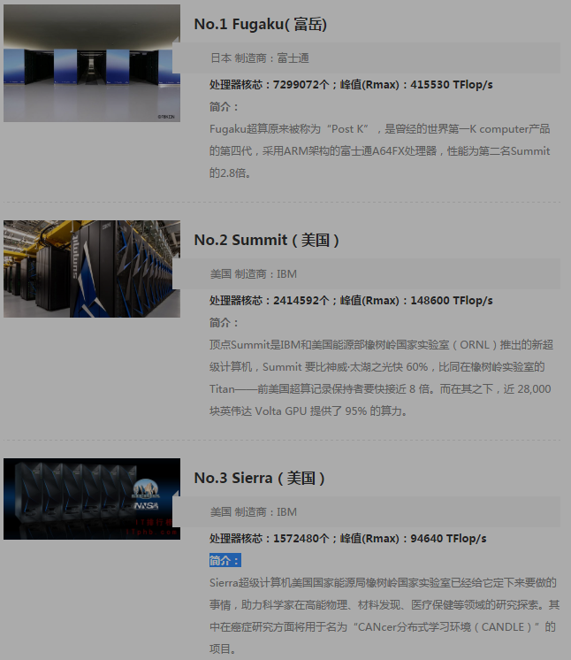
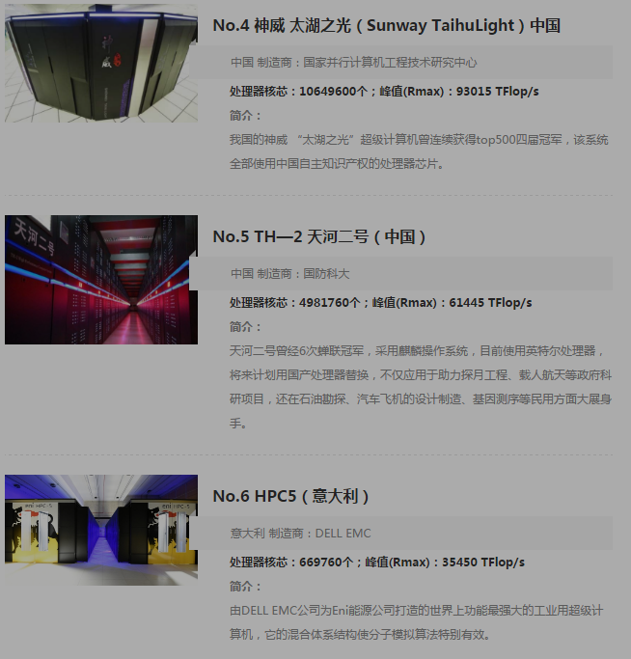
Newest Top 10 June 2020

Slide 48
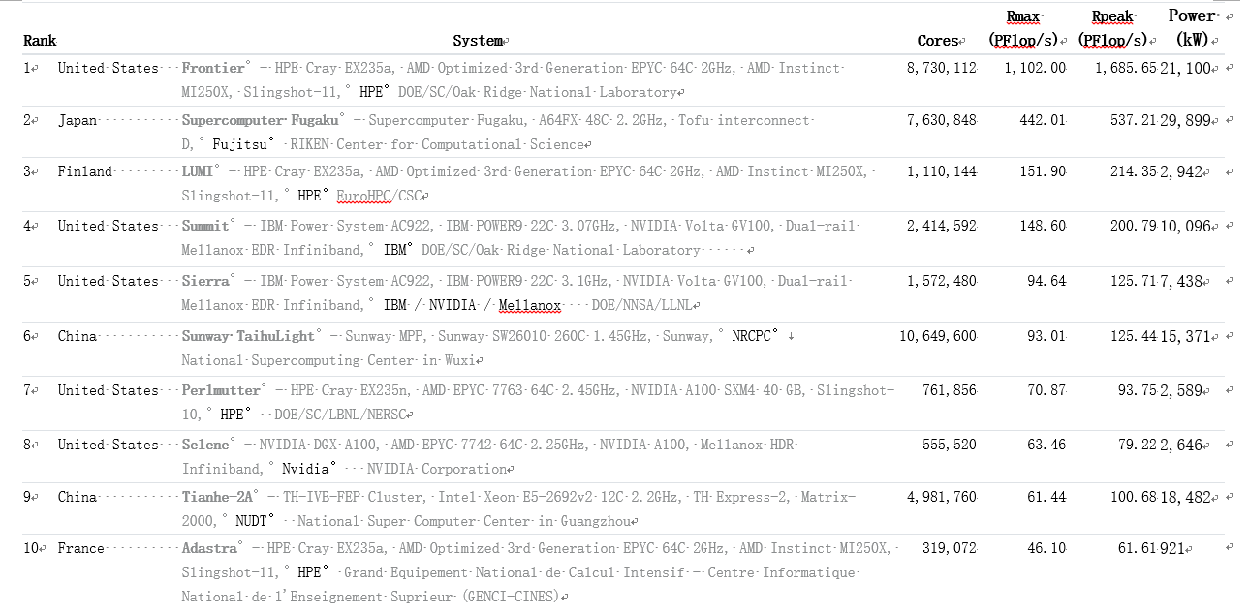
Fastest Supercomputer in the world from http://top500.org/ June. 2022

Slide 49
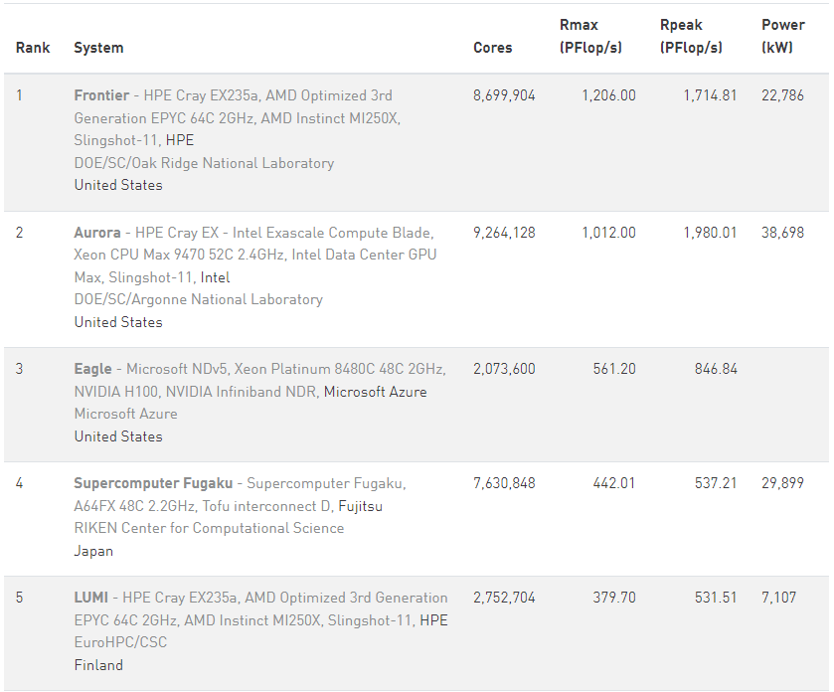
Fastest Supercomputer in the world from http://top500.org/ June. 2024

Slide 50
Chip technology
高纯硅要求99.999999999%,几乎全赖进口，传统霸主依然是德国Wacker和美国Hemlock(美日合资)
硅材料
晶圆
设计与制造
核心设备
封测
台湾的天下，排名世界第一的日月光，还跟着一堆实力不俗的小弟：矽品、力成、南茂、欣邦、京元电子。
大陆的三大封测巨头：长电科技、华天科技、
通富微电
一块300mm直径的晶圆，16nm工艺可以做出100块芯片，10nm工艺可以做出210块芯片，价格可便宜了一半
刻蚀机，中国的状况要好很多，16nm已经量产，7-10nm也在上
离子注入机70%的市场份额是美国应用材料公司
美英特尔、韩三星、日东芝、意法半导体；台湾的：旺宏电子；中国华润微电子等。 但中国高端芯片几乎空白
晶圆代工厂：
台积电，中芯国际
光刻机，荷兰阿斯麦公司(ASML)唯一高端光刻机生产商（12，24，40台/年）
高通、博通、AMD，
中国台湾的联发科，
大陆的华为海思

Slide 51
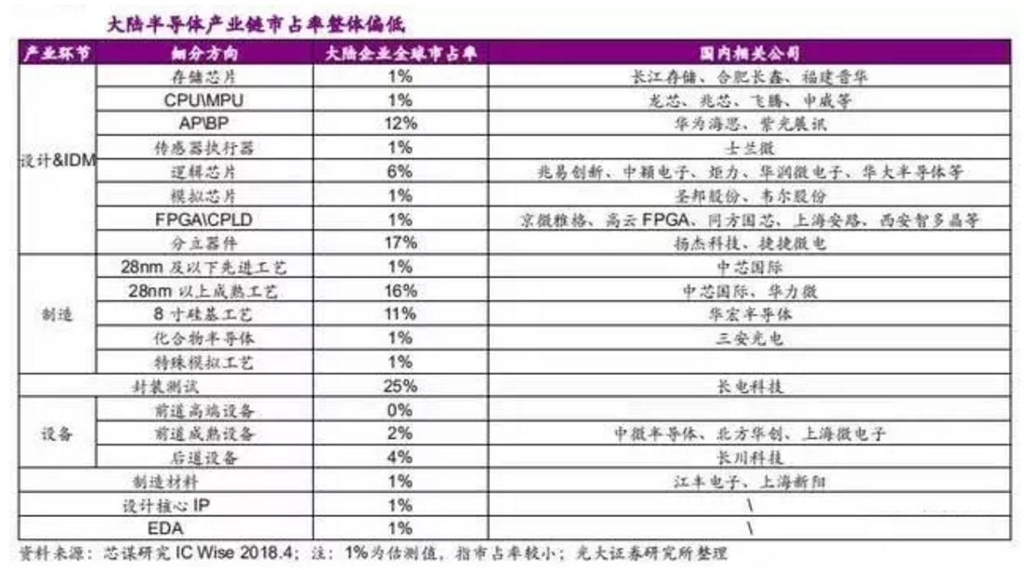
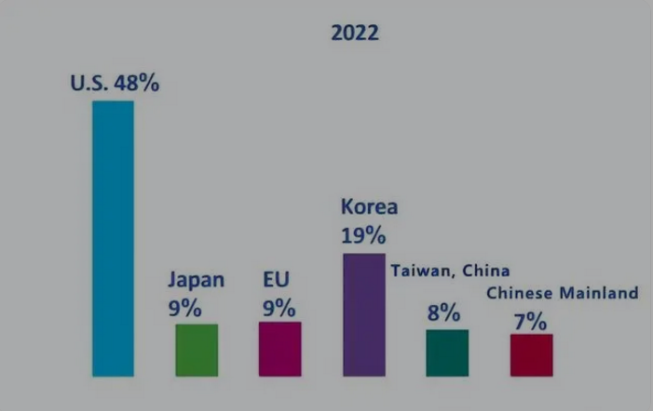
Chip technology
华为麒麟
芯片９１００
中国芯片的总体水平差不多处在刚刚实现零突破的阶段，虽然市场份额微乎其微，但每个领域都参了一脚，前景还是可期待的。
７ｎｍ工艺、５ｎｍ工艺
内插帧技术
神经网络处理单元ＮＰＵ
５Ｇ调制解调
生态系统和安全

Slide 52
What are the Big Bananas ?
Eckert-Mauchly Award
http://www.computer.org/portal/web/awards/eckert
Administered jointly by ACM and IEEE Computer Society. The award of $5000 is given for contributions to computer and digital systems architecture where the field of computer architecture is considered at present to encompass the combined hardware-software design and analysis of computing and digital systems.

Slide 53
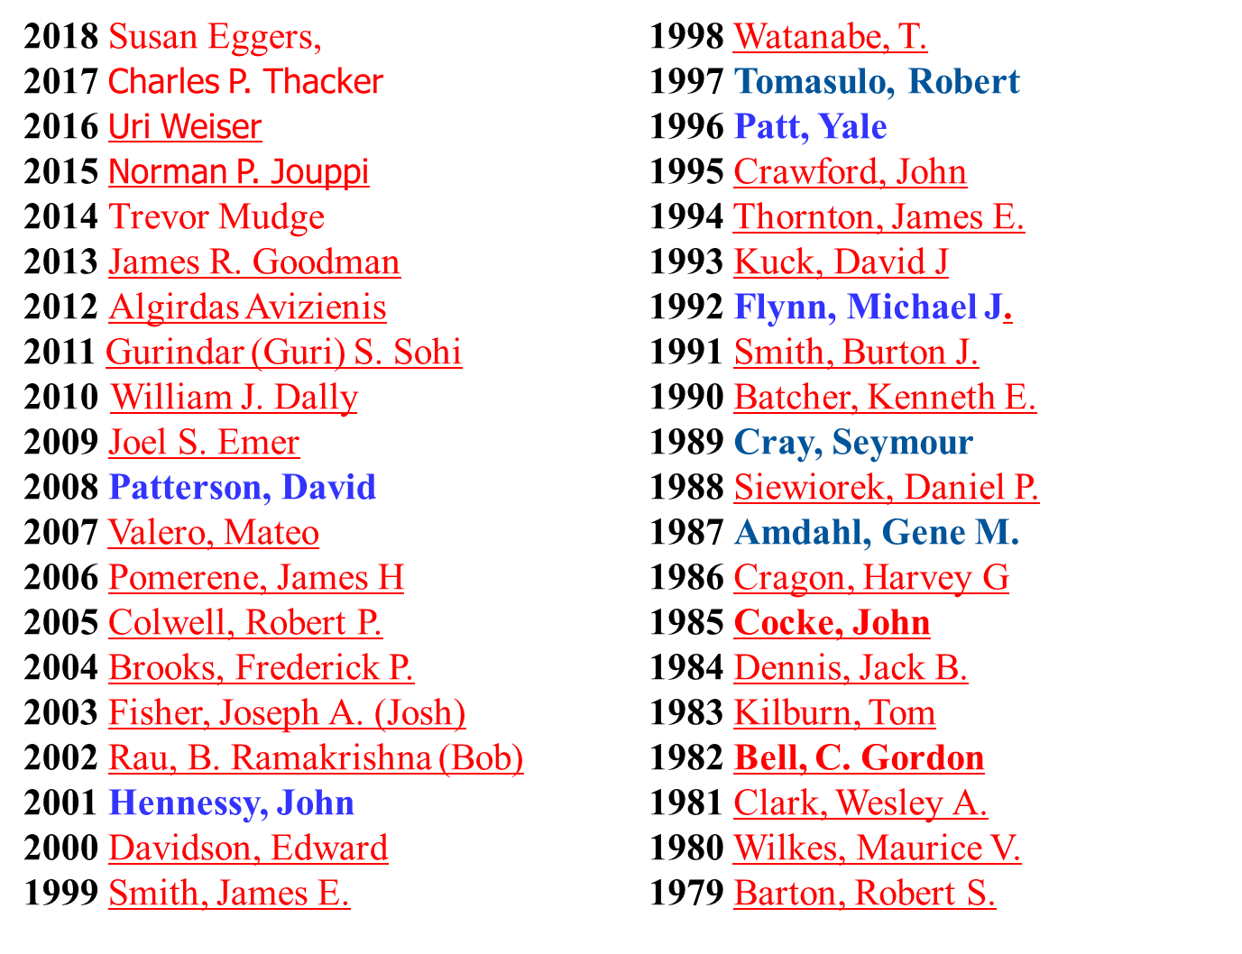
Eckert-Mauchly Award Recipients
2024 Wen-mei W. Hwu
2023 Kunle Olukotun
2022 Mark Horowitz
2021 Margaret martonosi
Luiz A. Barrso
2019 Mark D. Hill
Hwu is recognized for pioneering and foundational contributions to the design and adoption of multiple generations of processor architectures. His fundamental and pioneering contributions have had a broad impact on three generations of processor architectures: superscalar, VLIW, and throughput-oriented manycore processors (GPUs).

Slide 54
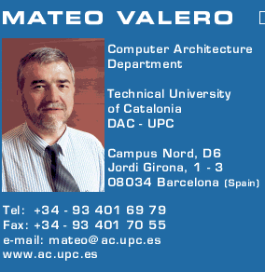
Big Men in Architecture(1)
2007Mateo Valero
http://personals.ac.upc.edu/mateo/
For important contributions to instruction level parallelism and superscalar processor design.

Slide 55
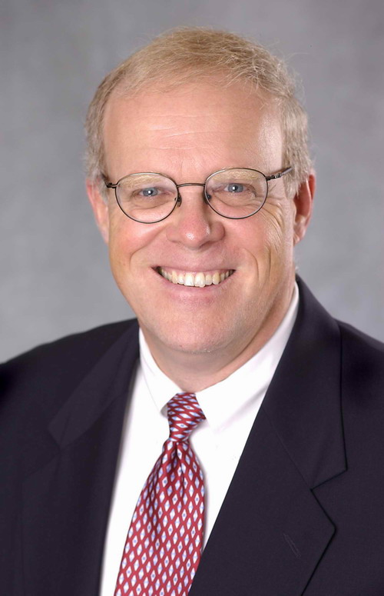
Big Men in Architecture(2)
2001 Hennessy, John
For being the founder and chief architect of the MIPS Computer Systems and contributing to the development of the landmark MIPS R2000 microprocessor.

Slide 56
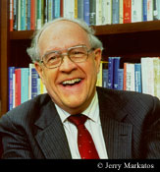
Big Men in Architecture(3)
2004 Eckert-Mauchly Award
"For the definition of computer architecture and contributions to the concept of computer families and to the principles of instruction set design; for seminal contributions in instruction sequencing, including interrupt systems and execute instructions; and for contributions to the IBM 360 instruction set architecture."
Frederick P. Brooks
http://www.cs.unc.edu/~brooks/
1999 ACM Turing Award
landmark contributions to computer architecture, operating systems, and software engineering."

Slide 57
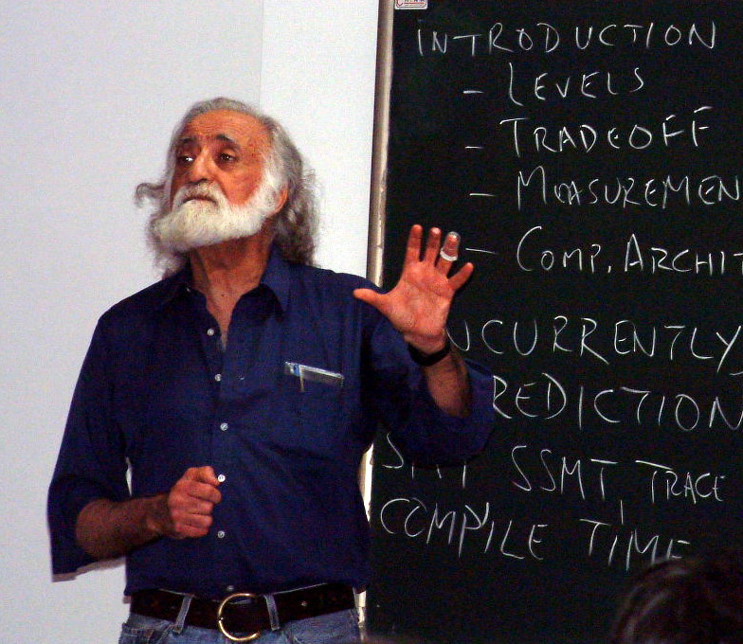
Big Men in Architecture(5)
1996 Yale Patt
For important contributions to instruction level parallelism and superscalar processor design.
Introduction to computing systems
（2013-2017, 2019）

Slide 58
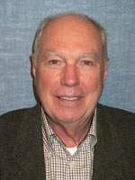
Big Men in Architecture(6)
1992 Michael J. Flynn
http://www.cpe.calpoly.edu/IAB/flynn.html
For his important and seminal contributions to processor organization and classification, computer arithmetic and performance evaluation.

Slide 59
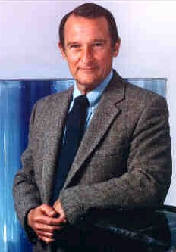
Big Men in Architecture(7)
1989 Cray, Seymour
For a career of achievements that have advanced supercomputing design.

Slide 60
Big Men in Architecture(8)
1987 Amdahl, Gene M. For outstanding innovations in computer architecture, including pipelining, instruction look-ahead, and cache memory.
In 1975, Dr. Amdahl stands beside the Wisconsin Integrally Synchronized Computer (WISC), which he designed in 1950. It was built in 1952. (Image courtesy of Dr. Gene M. Amdahl.)

Slide 61
Top conferences and Journals
Top conference:
ISCA
MICRO,
ASPLOS, SC, HPCA, DAC, …
Top journals:
TOCS ： ACM Tran. On Computer systems
TOCS：ACM Tran. on Storage
TCAD：IEEE Tran. On Computer-Aided Design of Integrated Circuis & Sys.
TC: IEEE Tran. On Computers
TPDS: IEEE Tran. On Parallel & Distributed Systems
TACO: ACM Tran. On Architecture and code optimization

Slide 62
What’s a CA designer’s task ?

Slide 63
Computer Design Engineering life cycle
Evaluating Existing
Systems for Bottleneck(app.A)
Benchmarks(1.8)
User requirement
Analysis(1.2)
Technology Trend 1.4
Power Trend 1,5
Cost Trend 1.6
Dependability 1,7
Quantitative Principles
1.9
Implement Next
Generation System
Simulate New
Designs and
Organizations
Workloads
Evaluating for energy-performance cost (1.8)
Notes:
Requirement Analysis:
Market analysis: who you will sell 4-1.2
desktop, server, embedded system, HPC
Different markets has different driven motivations.
When design a desktop, it aims to obtain best price-performance.
For the servers, dependability is critical, then the scalability, and throughput.
For the embedded computer systems, price is a key factor, while real-time performance is important . And power efficiency and memory size is always under consideration.
2. Functional requirement: 4-1.3
3. Performance requirement:
4. Power
5. Unfuntional requirements: availability, dependibility 1.7
7. Cost/price

Slide 64
Topics in Chapter 1
1.1 Introduction
1.2 Classes of computers
1.3 Defining computer architecture and What’s the task of computer design?
1.4 Trends in Technology
1.5 Trends in power in Integrated circuits
1.6 Trends in Cost
1.7 Dependability
1.8 Measuring, Reporting and summerizing Perf.
1.9 Quantitative Principles of computer Design
1.10 Putting it altogether

Slide 65
Summary: Task of computer design
Considerations:
functional and non functional requirements
implementation complexity
Complex designs take longer to complete
Complex designs must provide higher performance to be competitive
Technology trends
Not only what's available today, but also what will be available when the system is ready to ship. (more on this later)
Trends in Power in IC
Trends in cost
Arguments
Evaluate Existing Systems for Bottlenecks
Quantitative Principles

Slide 66
Reading Assignments
Chapter 1， App A.
Homework1 for chapter 1 will be loaded on website

Slide 67
End !
Thank you !

